Slide 1
S GN IT UP

Slide 2
Table of contents
01.
02.
03.
Problem Statement
Solution
Features
04.
05.
06.
Business Model
Prototype & ML Model
SWOT Analysis

Slide 3
01.
PROBLEM STATEMENT

Slide 4
PROBLEM STATEMENT
Deaf and dumb people face significant challenges in traditional video calling
platforms, as they heavily rely on visual
cues and sign language for communication.
Existing video calling solutions do not incorporate sign language recognition technology. As a result, deaf and dumb individuals are unable to fully express themselves through sign language, limiting
their ability to communicate naturally.

Slide 5
Fact !
About 1 billion people in the world live with disabilities
5 million
About 5 million people have absolute deafness
… among them, about 275 million have hearing loss

Slide 6
02.
SOLUTION
SOLUTION

Slide 7
SOLUTION
Our goal is to create a video calling website that provides an inclusive and accessible platform for deaf and dumb individuals, facilitating effective communication and enhancing their overall participation in virtual conversations. By addressing the unique needs and challenges faced by this community, the website aims to bridge the communication gap and promote inclusivity and equality in the digital realm.
This website will incorporate advanced technologies to address the unique communication challenges faced by this community.

Slide 8
About our Website
The website's speech recognition technology enables deaf individuals to understand spoken language through real-time transcription, enhancing their participation in video calls.
The intuitive design and simple controls make the website easy to navigate, ensuring a seamless communication experience for both deaf and hearing users.
F

Slide 9
Features
03.
Website
Sign language recognition & translation
Speech–to- text conversion

Slide 10
Features
Website
The website will provide a video calling feature that supports real-time communication. Deaf users can communicate through sign language while hearing users can speak. The video interface will be designed to accommodate both sign language gestures and spoken language. This will ensures that both deaf and hearing participants can easily understand and engage in the conversation.
Speech–to- text conversion
Speech recognition technology will be utilized to convert spoken language into text. Deaf users will be able to read the transcriptions of spoken words during video calls. The converted text will be displayed alongside the video feed for easy comprehension.
Sign language recognition & translation
Advanced computer vision algorithms will be implemented to recognize and interpret sign language gestures. The website will translate sign language into text, making it accessible to hearing individuals. Translated text will be displayed alongside the video feed during video calls.

Slide 11
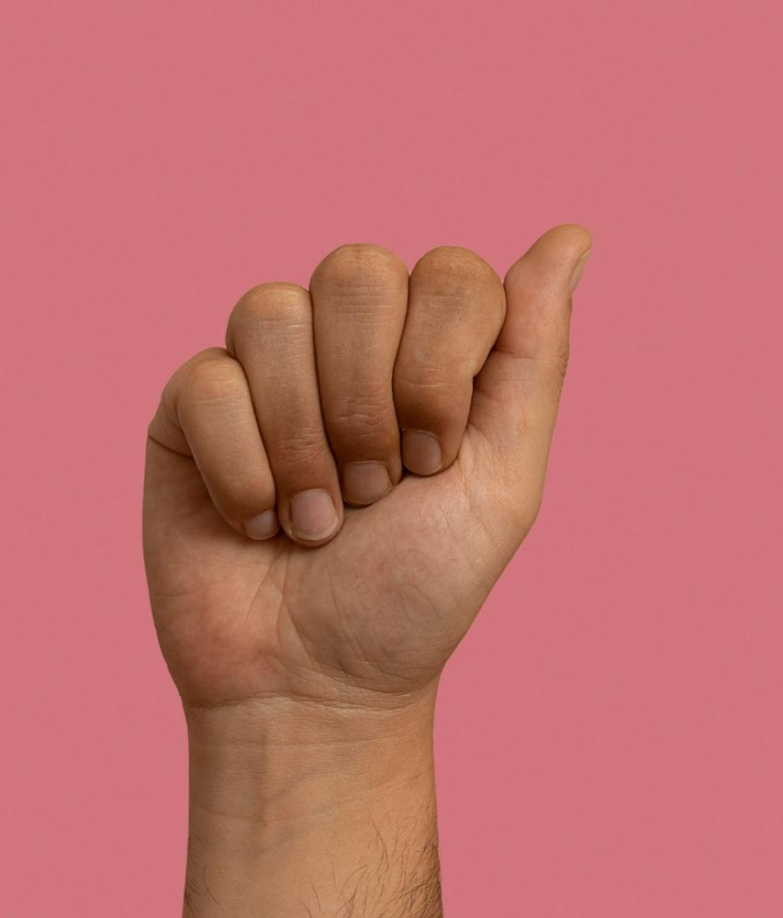
Alphabet A in Sign Language
A
Tierra
La Tierra alberga vida
Saturno
Saturno tiene anillos

Slide 12
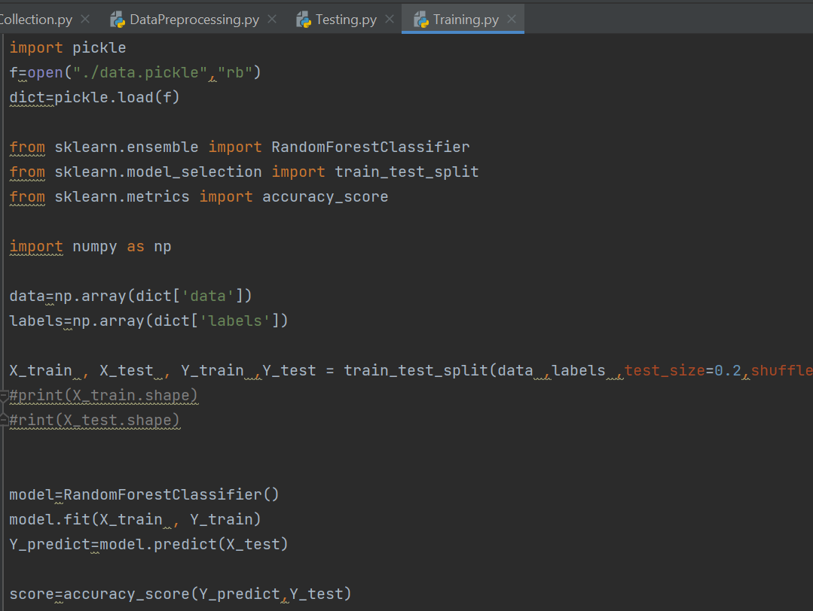
ML MODEL & LIBRARIES USED
Random
Forest
Random Forest is a ensemble learning method that is used in our ML model for classification tasks. Random Forest combines the predictions of many decision trees to classify images. It uses randomness and voting to make robust and accurate predictions.

Slide 13
Computer Vision - Version 2
CV2 has helped in Image Loading & Manipulation. It allows us to load, display, and manipulate images in various formats. CV2 has performed operations like resizing, cropping, rotating, flipping, contrast, & color channels.
CV 2
MediaPipe has provided a powerful solution for landmark detection in various applications, including facial landmark detection, hand pose estimation, and body pose estimation.
MediaPipe

Slide 14
Business Model

Slide 15
Business model
Collaborate with relevant businesses and organizations to display targeted ads on the website.
Form partnerships with institutions, schools, or companies that have a vested interest in supporting the deaf and mute community. Offer customized solutions and services for a fee.
The implications of our project extend to various domains, with significant impact on healthcare and education. In healthcare settings, effective communication is essential for accurate diagnosis and treatment. Our platform enables healthcare professionals to better understand their patient’s symptoms, needs, and emotions, leading to improved care and outcomes.
Similarly, within educational environments, our project provides students with communication disabilities an equal opportunity to actively participate, engage with their peers, and express their thoughts, creating inclusive learning spaces that promote growth and understanding.

Slide 16
SWOT ANALYSIS
Strenghts
Weakness
Opportunity
Threats
The website promotes inclusive communication between deaf & hearing individuals, bridging the gap & fostering understanding & collaboration.
The website may face limitations in recognizing & translating all sign language dialects accurately, potentially excluding users who communicate in less widely known dialects.
Collaborating with organizations, experts, and the deaf community can help improve the website's accuracy, broaden language support, & incorporate additional features based on user feedback & needs.
Overcoming the challenge of user adoption & raising awareness about the website's benefits among the target audience may pose a threat to its initial growth & success

Slide 17
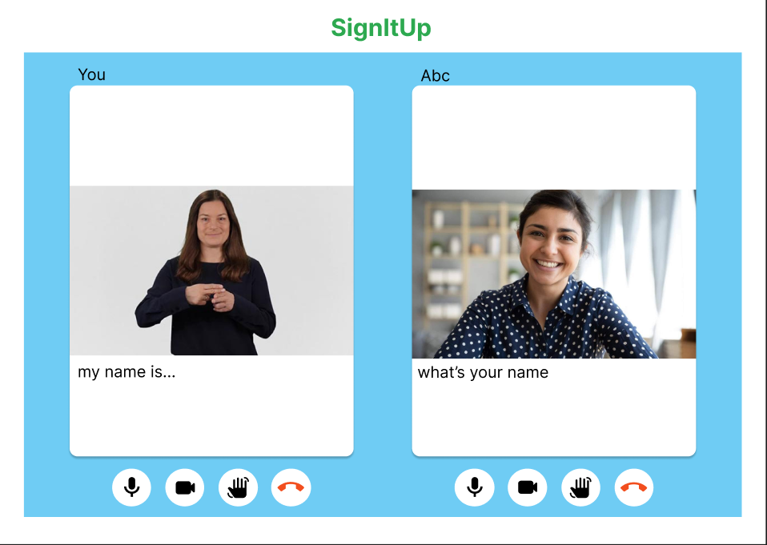
Prototype
https://www.figma.com/file/Prototype link

Slide 18
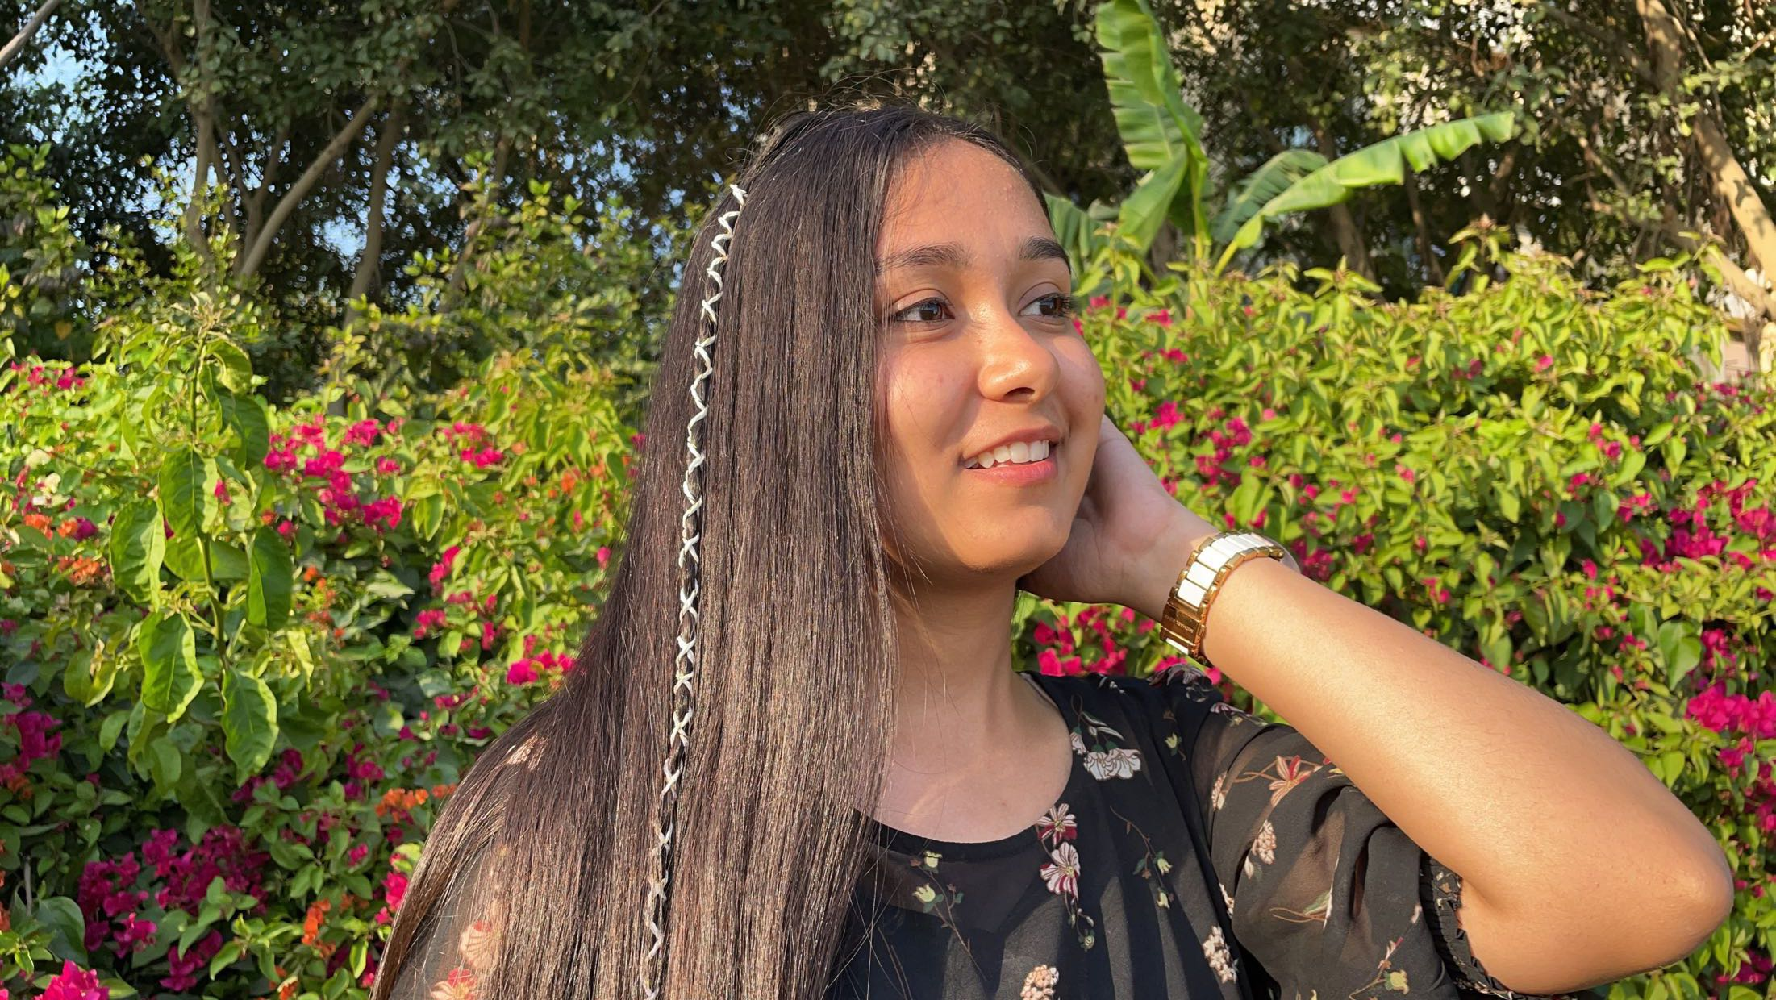
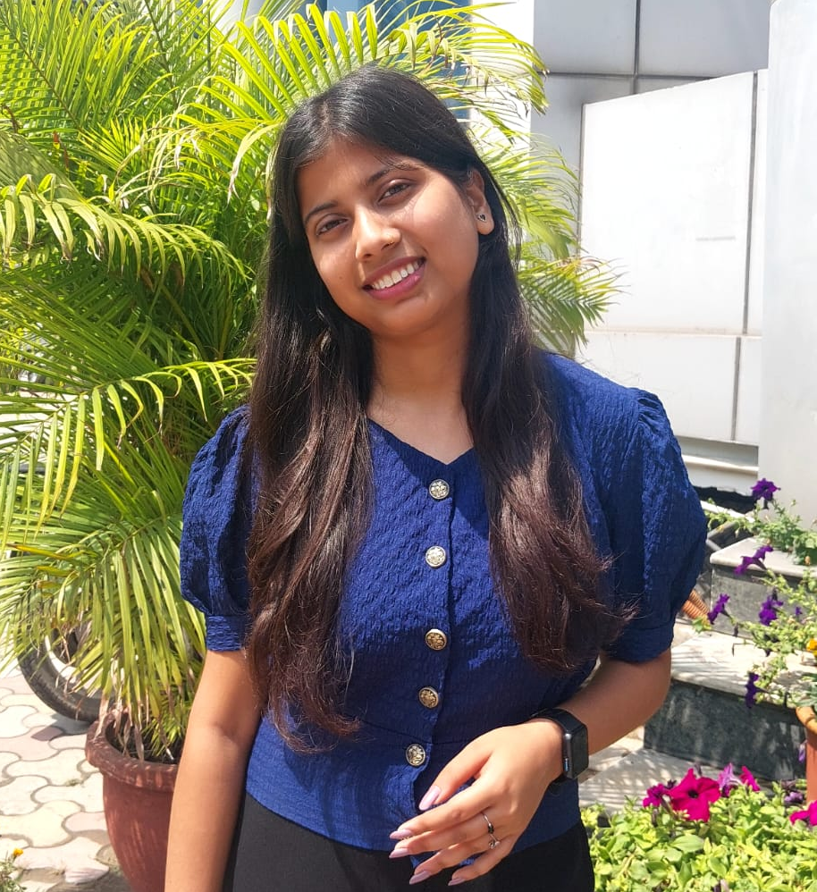
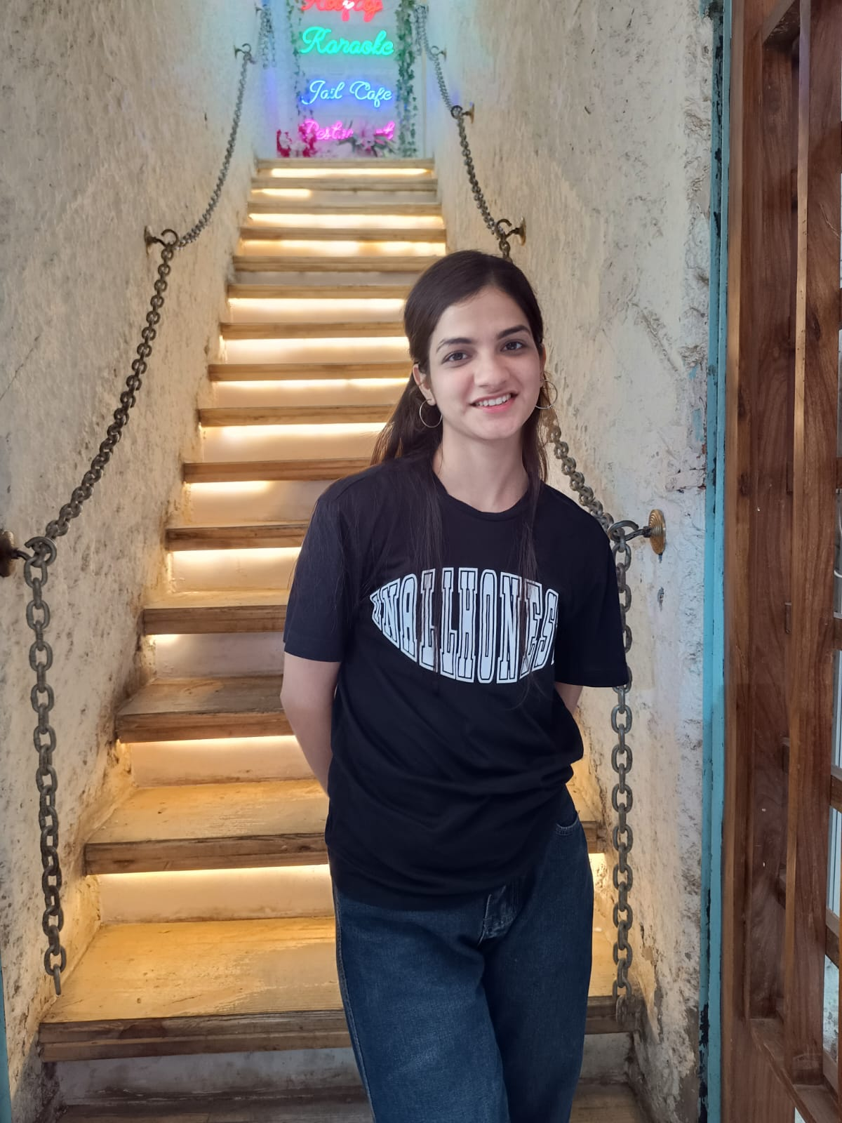

Our Team
Prabhleen Kaur
Anjali Dhoundiyal
Tanu Jha
Avneet Kaur

Slide 19

Thank you!

